Slide 1
Recap of the 2nd Law
The 2nd Law divides the question of spontaneity into two parts:
A system part that we can get at using differential equations of state for the entropy, and thermodynamic tables of entropy
A surroundings part that deals with the entropy change of the surroundings due to heat transfer, that we can get at using thermodynamic tables of enthalpy
Quantitative treatment lets us predict the temperature dependence of spontaneity
Qualitative interpretation of the 2nd Law: enthalpic and entropic favorability
An important caveat: mixing

Slide 2
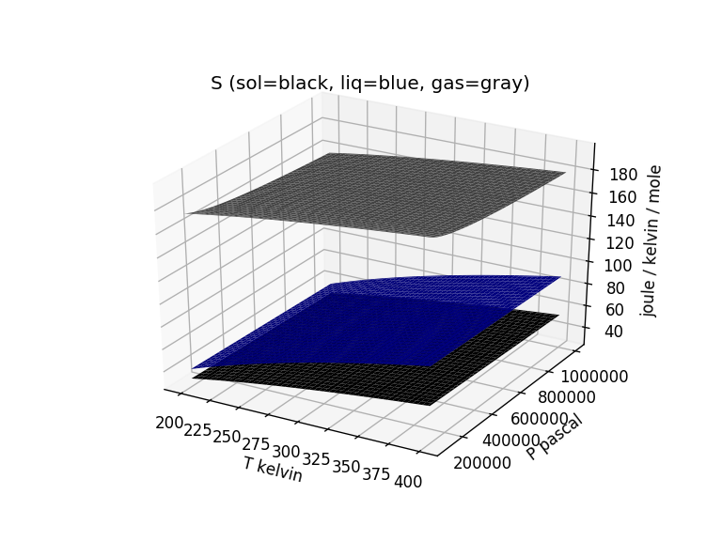
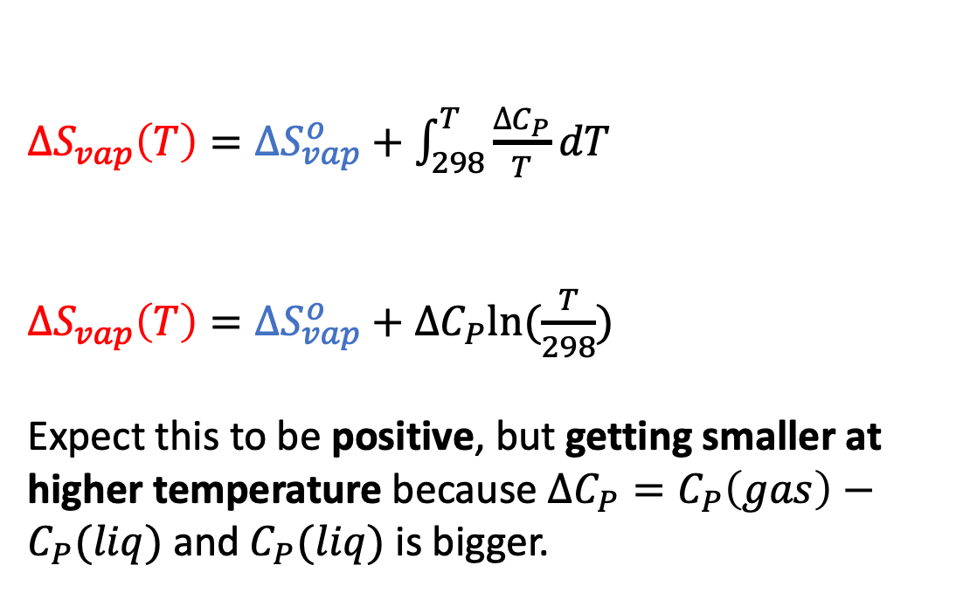
Calculating $∆S_{tot}(T)$ of vaporization of water
$$∆S_{tot}={∆S}_{vap}\left(T\right)+∆S_{surr}$$
${∆S}_{vap}\left(T\right)={∆S}_{vap}^{o}+\int_{298}^{T}{\frac{∆C_{P}}{T}dT}$
${∆S}_{vap}\left(T\right)={∆S}_{vap}^{o}+∆C_{P}ln⁡(\frac{T}{298})$
Expect this to be positive, but getting smaller at higher temperature because $∆C_{P}=C_{P}\left(gas\right)−C_{P}(liq)$ and $C_{P}(liq)$ is bigger.
119

Slide 3
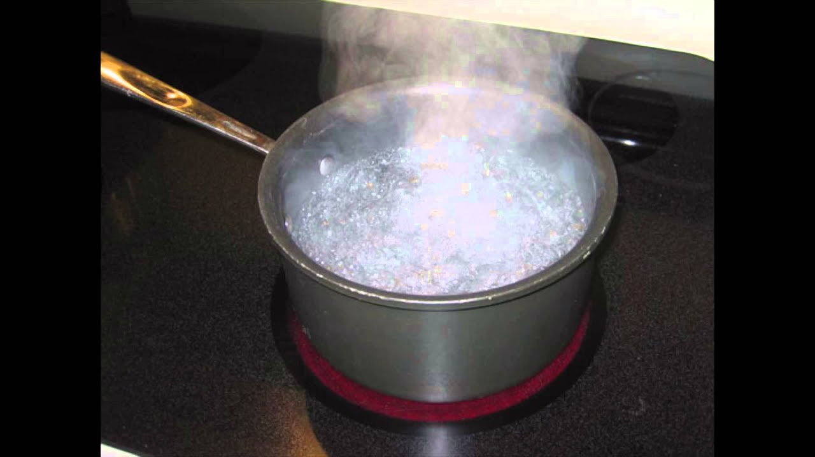
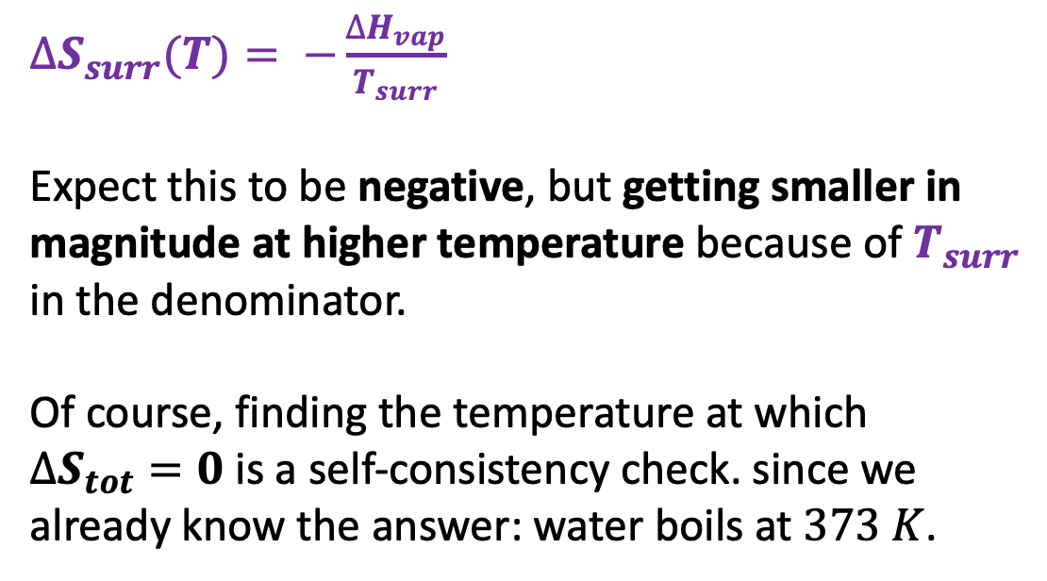
Calculating $∆S_{tot}(T)$ of vaporization of water
$$∆S_{tot}={∆S}_{vap}\left(T\right)+∆S_{surr}$$
$∆S_{surr}(T)= −\frac{∆H_{vap}}{T_{surr}}$
Expect this to be negative, but getting smaller in magnitude at higher temperature because of $T_{surr}$ in the denominator.
Of course, finding the temperature at which $∆S_{tot}=0$ is a self-consistency check. since we already know the answer: water boils at $373 K$.

Slide 4
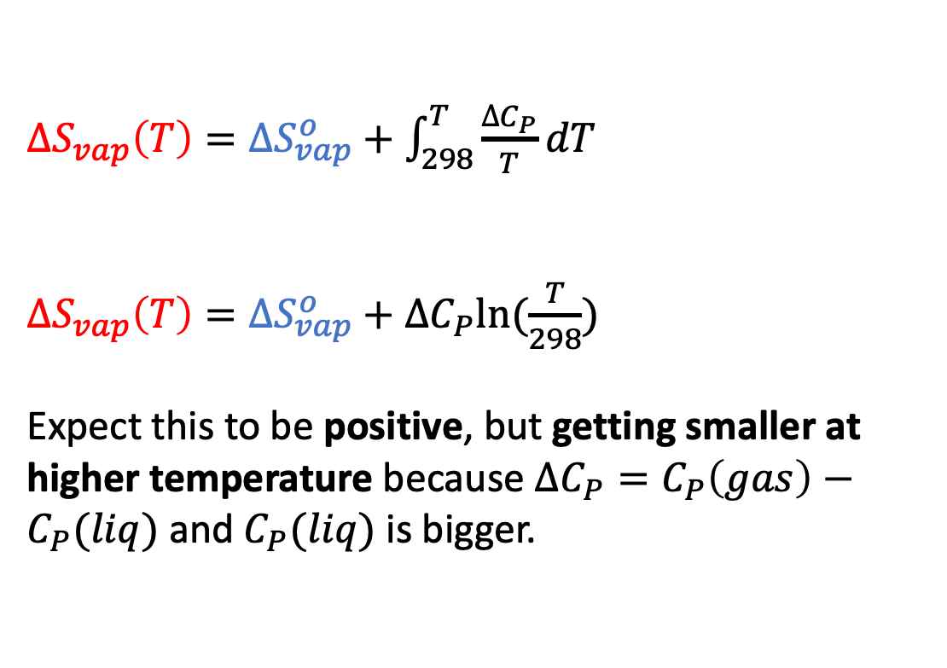
Calculating $∆S_{tot}(T)$ of vaporization of ethanol
$$∆S_{tot}={∆S}_{vap}\left(T\right)+∆S_{surr}$$
${∆S}_{vap}\left(T\right)={∆S}_{vap}^{o}+\int_{298}^{T}{\frac{∆C_{P}}{T}dT}$
${∆S}_{vap}\left(T\right)={∆S}_{vap}^{o}+∆C_{P}ln⁡(\frac{T}{298})$
Expect this to be positive, but getting smaller at higher temperature because $∆C_{P}=C_{P}\left(gas\right)−C_{P}(liq)$ and $C_{P}(liq)$ is bigger.
115

Slide 5
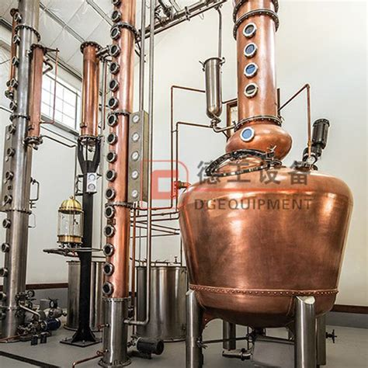
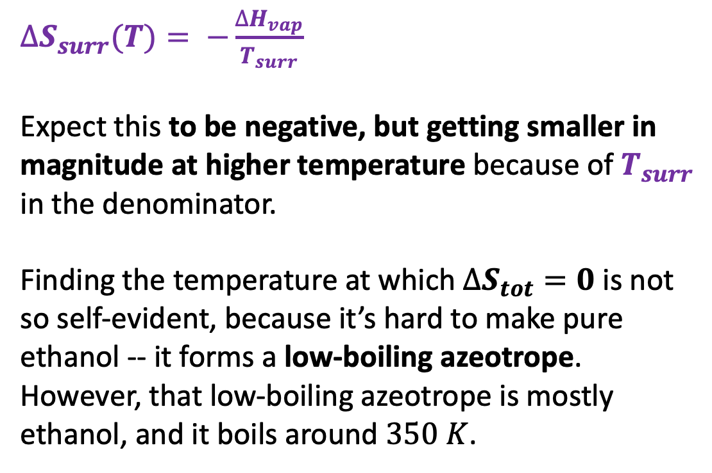
Calculating $∆S_{tot}(T)$ of vaporization of ethanol
$$∆S_{tot}={∆S}_{vap}\left(T\right)+∆S_{surr}$$
$∆S_{surr}(T)= −\frac{∆H_{vap}}{T_{surr}}$
Expect this to be negative, but getting smaller in magnitude at higher temperature because of $T_{surr}$ in the denominator.
Finding the temperature at which $∆S_{tot}=0$ is not so self-evident, because it’s hard to make pure ethanol -- it forms a low-boiling azeotrope. However, that low-boiling azeotrope is mostly ethanol, and it boils around $350 K$.

Slide 6
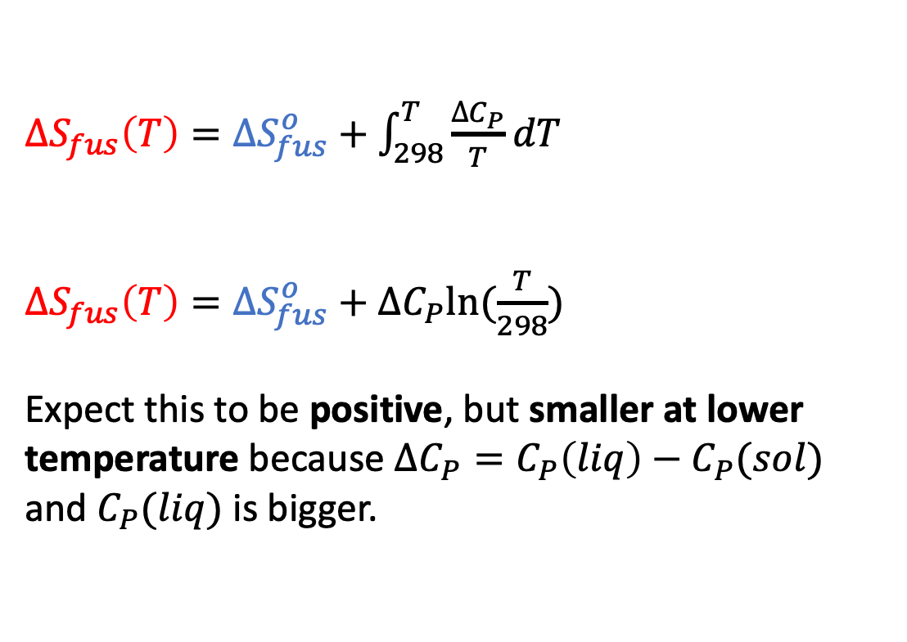

Calculating $∆S_{tot}(T)$ of melting of water
$$∆S_{tot}={∆S}_{fus}\left(T\right)+∆S_{surr}$$
${∆S}_{fus}\left(T\right)={∆S}_{fus}^{o}+\int_{298}^{T}{\frac{∆C_{P}}{T}dT}$
${∆S}_{fus}\left(T\right)={∆S}_{fus}^{o}+∆C_{P}ln⁡(\frac{T}{298})$
Expect this to be positive, but smaller at lower temperature because $∆C_{P}=C_{P}\left(liq\right)−C_{P}(sol)$ and $C_{P}(liq)$ is bigger.
$$25$$

Slide 7
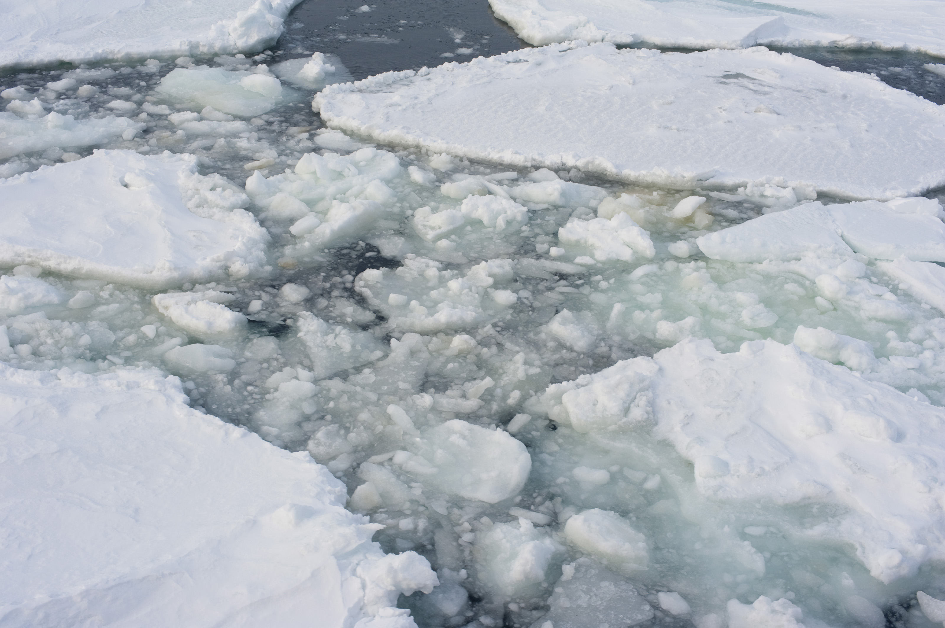
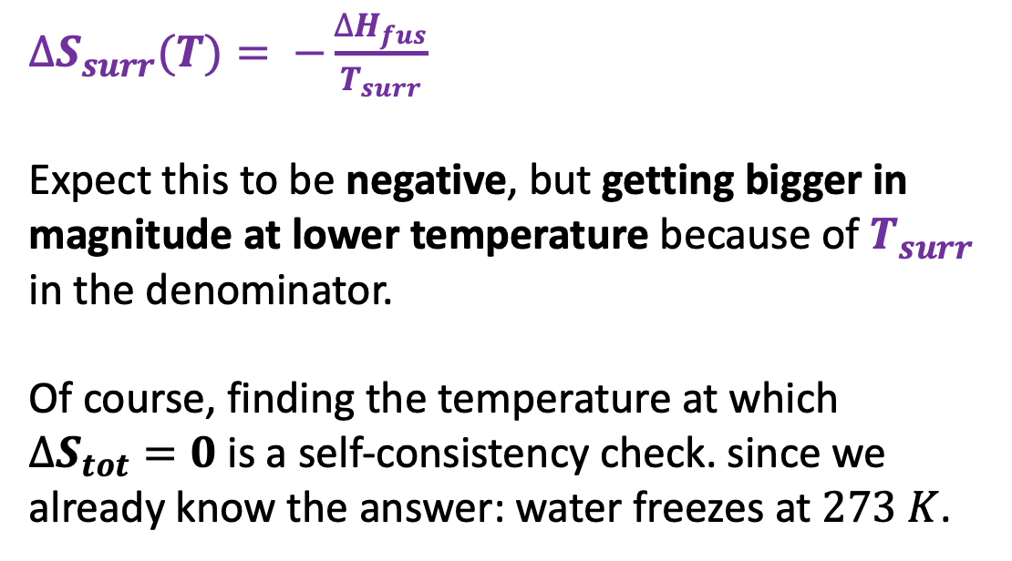
Calculating $∆S_{tot}(T)$ of melting of water
$$∆S_{tot}={∆S}_{fus}\left(T\right)+∆S_{surr}$$
$∆S_{surr}(T)= −\frac{∆H_{fus}}{T_{surr}}$
Expect this to be negative, but getting bigger in magnitude at lower temperature because of $T_{surr}$ in the denominator.
Of course, finding the temperature at which $∆S_{tot}=0$ is a self-consistency check. since we already know the answer: water freezes at $273 K$.

